Slide 1
Final Project Predicting Energy Consumption based on Weather Forecasts Presentation
Chris Kellam, Eric Lidiak, Matthew Smith, Molly Fox, Jason Britton

Slide 2
Project Summary
TOPIC: Predicting Energy Consumption based on Weather Forecasts
DESCRIPTION
Create a predictive model based on historical weather and energy consumption data to forecast energy consumption based on weather variables such as minimum, maximum and average temperature, state, and month of year.
RESEARCH QUESTIONS
What types of historical data are available for weather and energy consumption?
Is weather data a good predictor of energy consumption?
How do different models’ compare to one another for time-series prediction?

Slide 3
Data and Delivery
Datasets
Energy Data: U.S. Energy Information Administration https://www.eia.gov
Weather Data: https://asmith.ucdavis.edu/data/prism-weather
Each team member took a potential model library (ARIMA, Prophet, Random Forest, LSTM, XGBoost) to compare and contrast the libraries predictive power using the two data sets.
The weather data began in January 1981 and continued through December 2023. The energy data began in January 2001 and continued through September 2024. We narrowed the scope of the combined data from January 2001 to December 2023.
Preprocessing was conducted jointly and individually based on the needs of the various models.

Slide 4
Model Accuracy
ARIMA
Prophet
Random Forest: MAE of 881.04 and an R² score of 0.47
LSTM: MAE of 729.74 and an R² score of 0.10
XGBoost: 81.18% Accuracy with a RMSE value of 2576.06
The team used the same features and target to test predictions:
Features: tmin, tmax, tavg, year, month, state_Texas
Target: coal

Slide 5
Key Observations
Weather data serves as a decent predictor of energy consumption, as indicated by the models' predictive capabilities.
Monthly weather trends reveal that average temperature patterns correlate with energy consumption, highlighting the influence of seasonal changes.
Weather temperatures—both hot and cold—are likely to impact on future energy consumption, necessitating further analysis to understand their effects.
And the winner is…[insert model here]!

Slide 6
Feature Engineering
Initial attempts to model with one-hot encoded states resulted in excessive dimensionality, complicating the analysis.
Considered adding numeric values for states and regions, but this could cause models to treat categorical variables as continuous.
Random Forest: calculated sine and cosine to capture cyclical patterns, but this led to decreased accuracy..

Slide 7
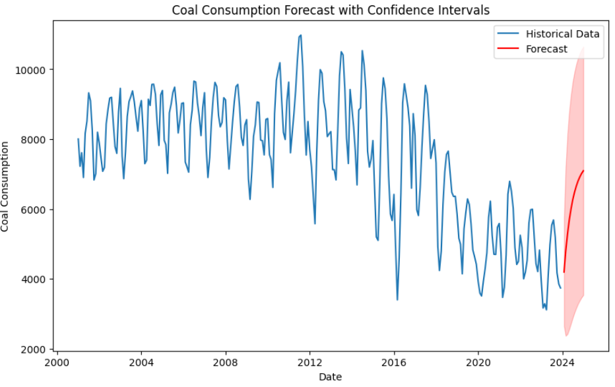
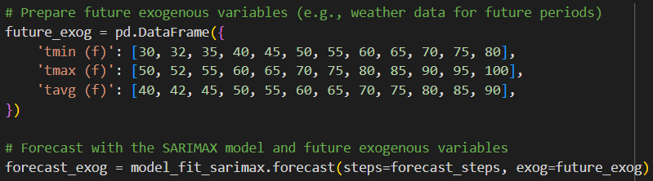
Model: ARIMA
The ARIMA model had an average RMSE value of 1771.17, Mean Absolute Error of 1494.48, and R-squared value of 0.06 (indicating the model explains only about 6.32% of the variability in coal consumption).
Auto-ARIMA was used to find the best parameters. “ARIMA(2,1,1)(0,0,0)[0]” was identified to be the best model.
The model was asked to predict coal consumption for January to May 2024 based off of data from January 2001 to December 2023:
Predicted coal consumption
January 2024 | 4193
February 2024 | 4789
March 2024 | 5276
April 2024 | 5673
May 2024 | 5998

Slide 8
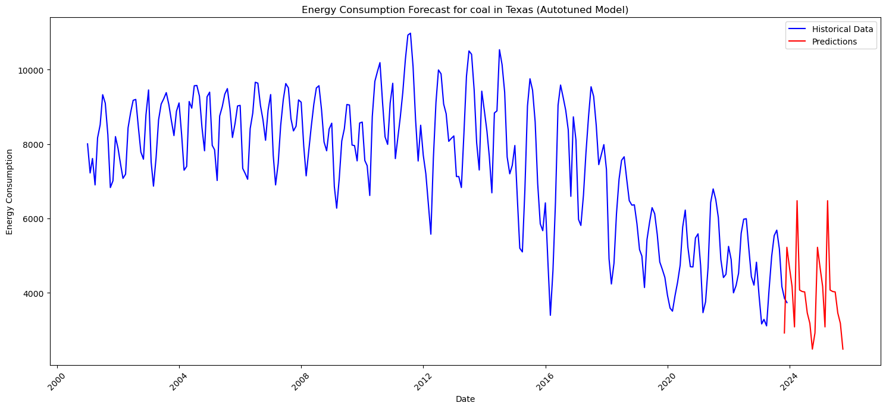
Model: XGBoost
The XGBoost model had a predictive accuracy of 81.18% with an average RMSE value of 2576.06.
Autotuning was used for dialing the model in. The best parameters were: {'subsample': 1.0, 'n_estimators': 2000, 'min_child_weight': 5, 'max_depth': 5, 'learning_rate': 0.3, 'colsample_bytree': 1.0}
Given values for Texas in December 2023 for the various features:
'year': [2025], 'month_num': [12], 'tmin': [2.652], 'tmax': [15.471], 'tavg': [9.062], 'ppt': [94.212]
The model was asked to predict coal consumption for Texas in December 2025. The model predicted a value of 2871
thousand tons. The actual coal
consumption for Texas in December
2023 was 3736. A difference of 865
thousand tons.

Slide 9
Model: Random Forest
Initial MSE of 3,045,606 and an R² value of 0.26.
RandomizedSearchCV improved the MAE to 881 and R² score to 0.47, indicating only 47% of the variability in energy consumption is captured.
Random Forest Time-Series Analysis Challenges:
The model assumes that observations are independent and non-sequential, which is not the case in time-series data.
It does not effectively utilize lagged values and seasonal indicators, which are crucial for capturing temporal patterns.
The decision trees used in the model split the data into homogeneous groups that fail to capture cyclical patterns or trends over time.
Random forest is prone to overfitting, which can lead to poor performance when applied to time-series data.

Slide 10
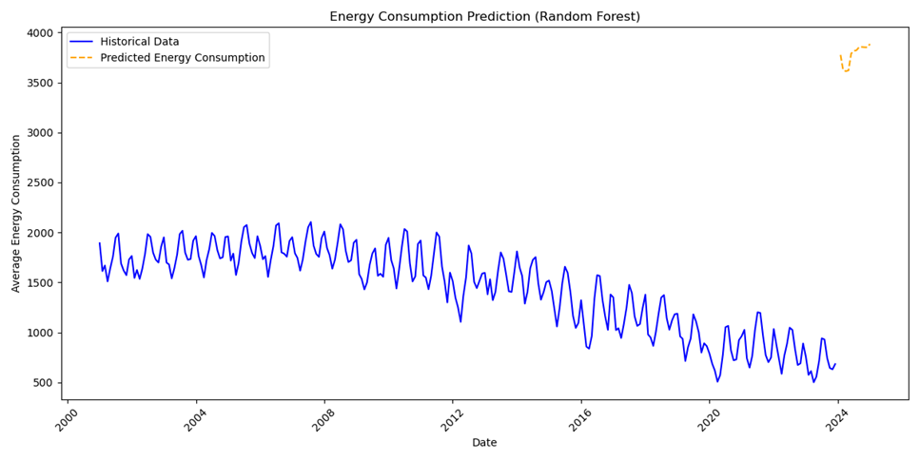
Model: Random Forest

Slide 11
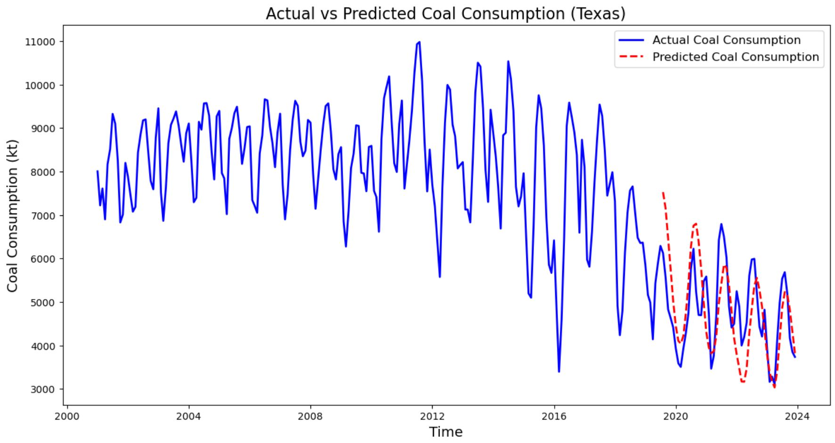
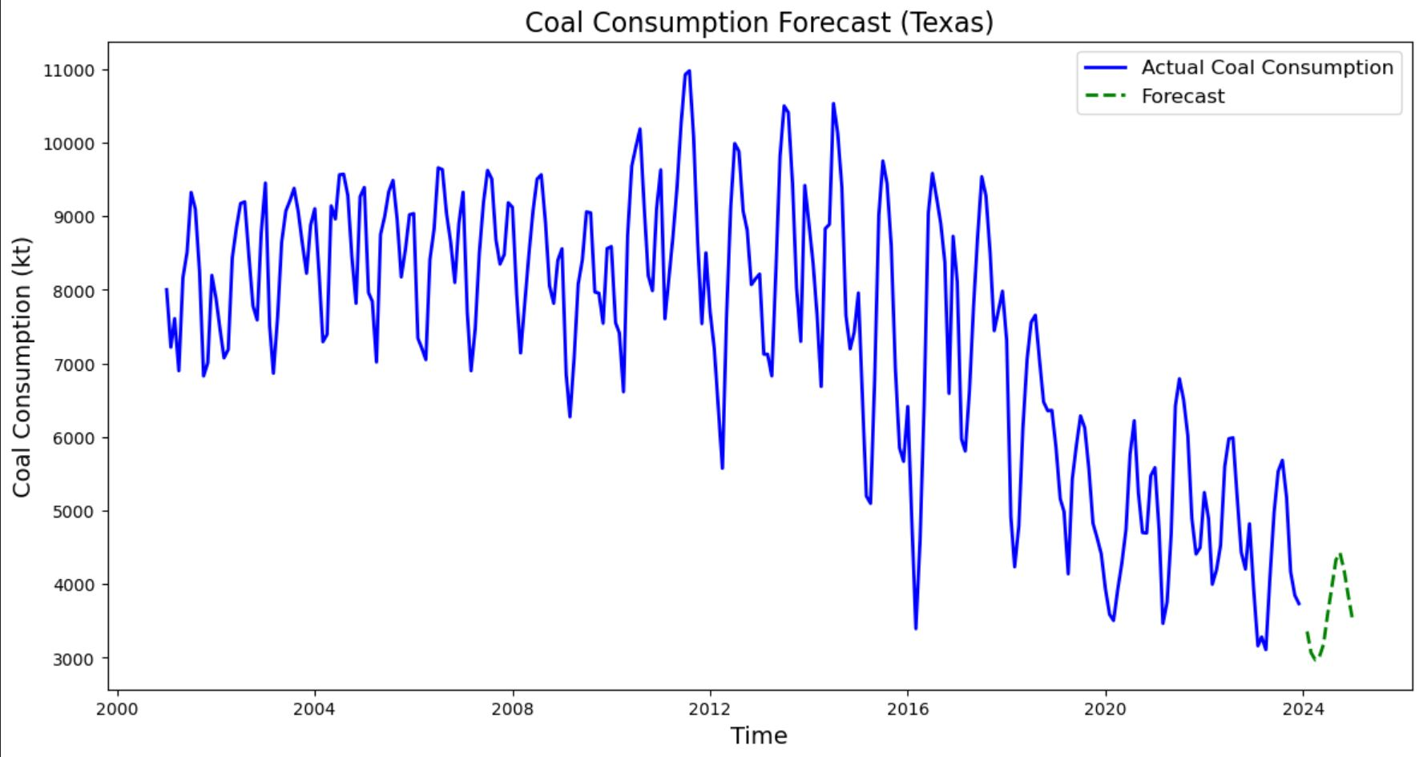
Model: LSTM
The best results were a MAE of 729.74, RMSE of 864.43, and R² score of 0.10%.
The parameters used for this model were: sequence length: 15, 1 hidden layer, 50 units/layer, 50 epochs.
I tried using an optimization function to find the best parameters for this model, but it was unable to find anything that performed better than what used for the above model.

Slide 12
Meta Prophet
Prophet is a model from Meta/ Facebook
The model only allows one input parameter
The model does allow for seasonality and holidays
Neural Prophet may have better results

Slide 13
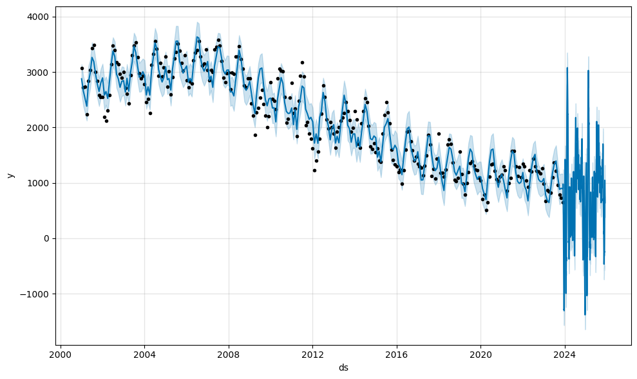
Meta Prophet

Slide 14
Meta Prophet
horizon mse rmse mae
0 37 days 1.093213e+06 1045.568034 827.816340
1 38 days 1.087036e+06 1042.610281 828.718786
2 40 days 1.065286e+06 1032.126874 814.787089
3 41 days 1.059688e+06 1029.411259 811.562895
4 42 days 1.091931e+06 1044.955242 842.449406

Slide 15
Thank You

